Slide 1

DATA SCIENCE PROGRAMMING PROJECT
COMPILED BY:
SANIYA ISLAM
RAUSHAN kumar
ANOOP BHARADWAJ

Slide 2

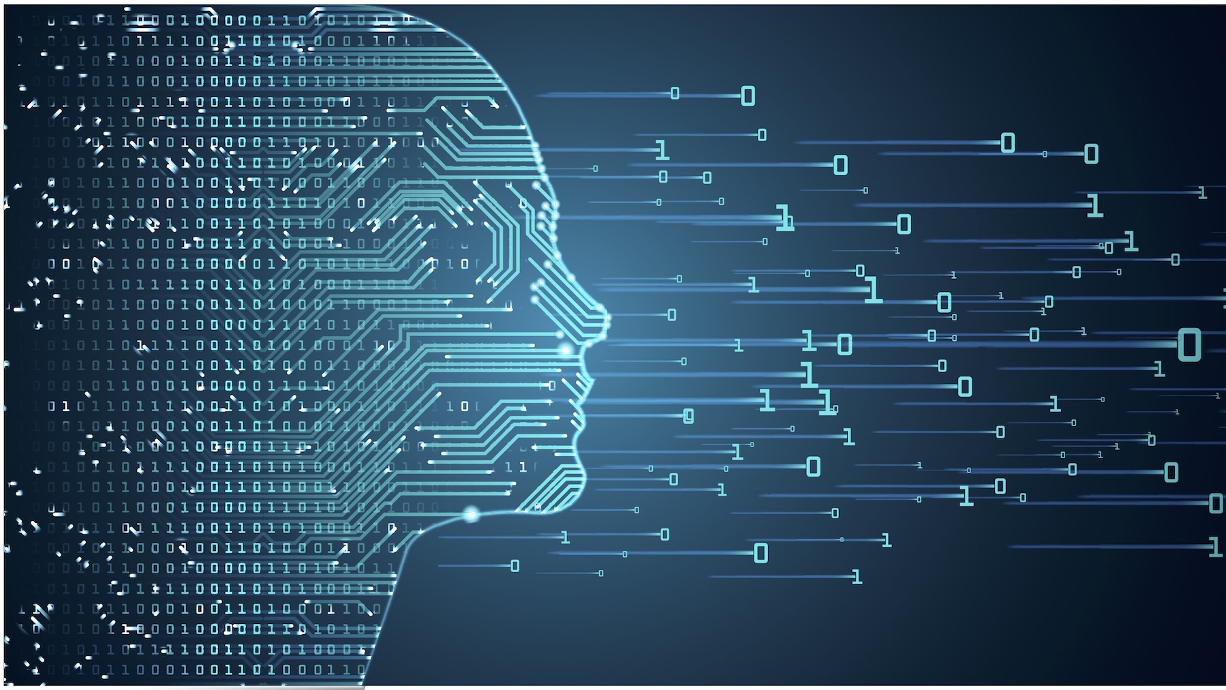
USF Logo recognition

Slide 3
agenda
Logo recognition in images has been gaining considerable attention in the last decade, with such applications as copyright infringement detection, intelligent traffic-control systems, and automated computation of brand-related statistics.

Slide 4
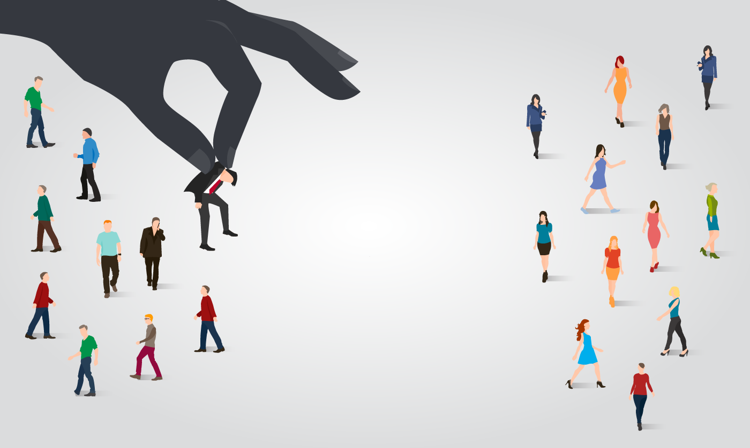
PROBLEM DEFINITION
Given a set of USF AND NON-USF images and prior knowledge about the content of the images IDENTIFY the correct image

Slide 5

APPROACH
1. GATHERING DATA
2. DATA PREPARATION
3. CHOOSING A MODEL
4. TRAINING
5. EVALUATION
6. PREDICTION

Slide 6
GATHERING DATA
1. gathered IMAGES FOR USF LOGOS
2. gathered IMAGES FOR OTHER COLLEGE LOGOS
3. gathered IMAGES FOR USF AS A TINY PART OF FULL IMAGE
4. gathered RANDOM IMAGES
5. Added noise in usf logos

Slide 7
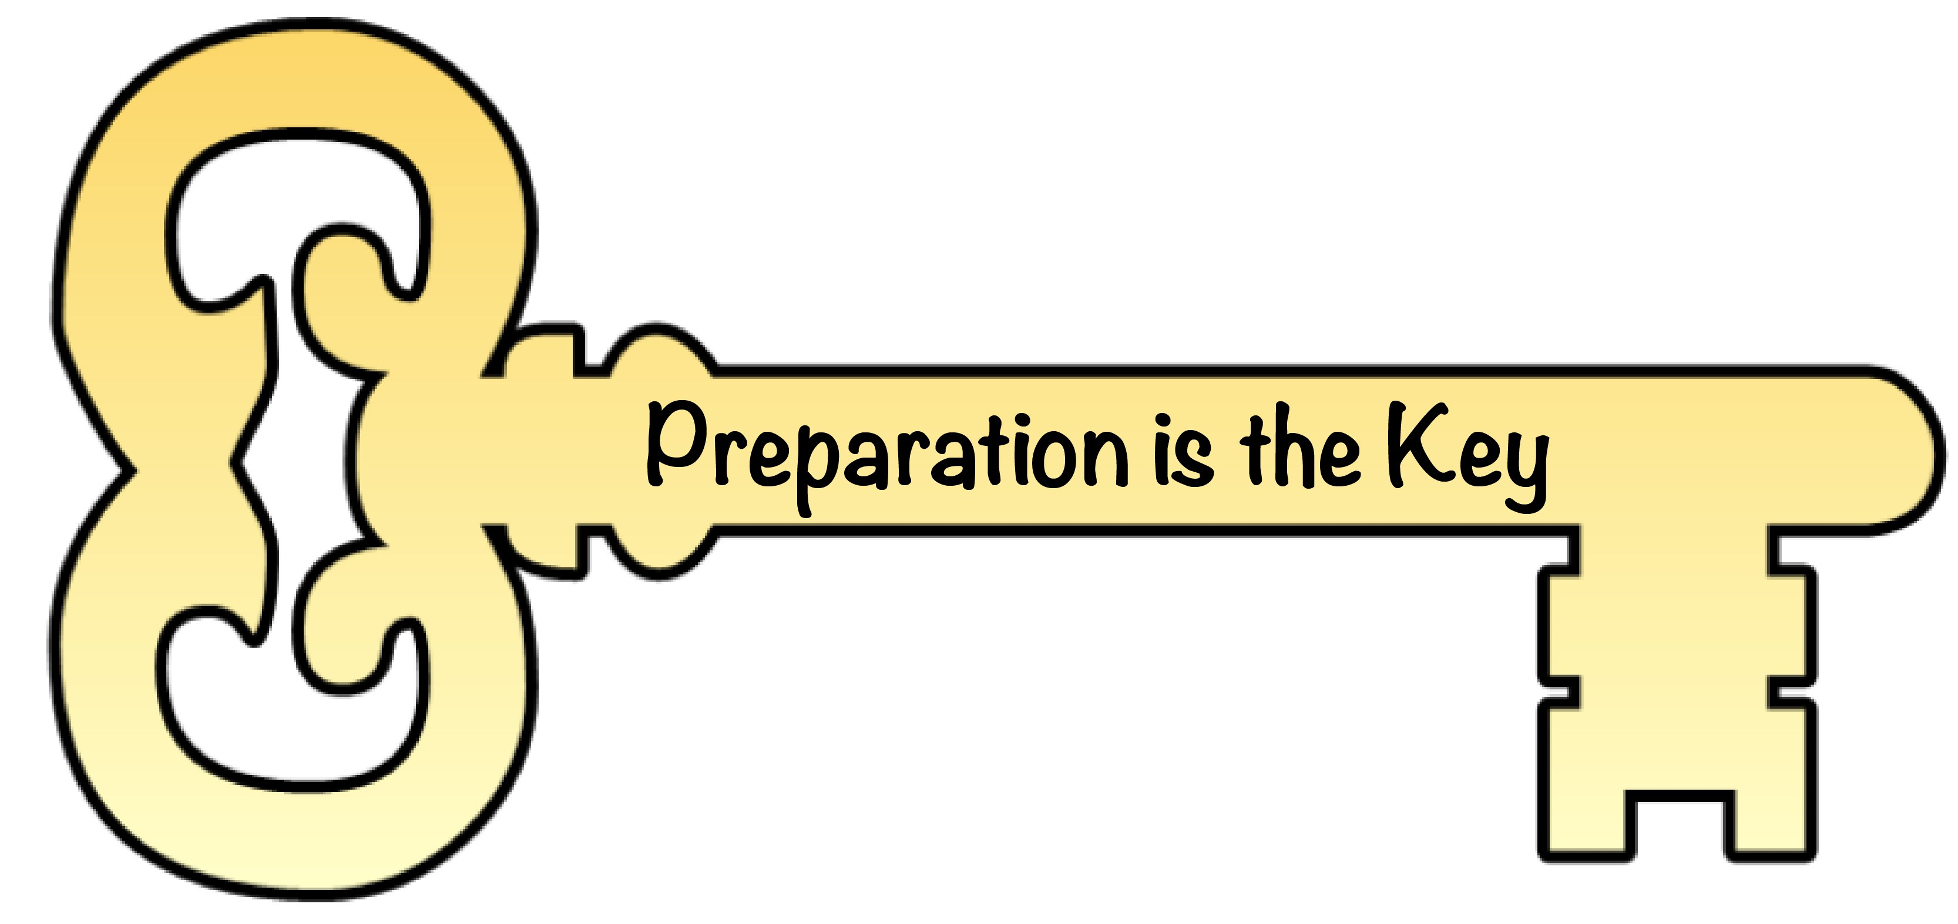
DATA PREPARATION
5 DATASETS CREATED (MERGING OF DATA)
1. USF AND NON-USF LOGOS (RATIO 200/100)
2. USF AND NON-USF LOGOS(RATIO 200/150)
3. usF AS TINY PART OF IMAGE AND RANDOM IMAGES
4. USF LOGO AND RANDOM IMAGES
5. USF LOGO WITH NOISE AND RANDOM IMAGES

Slide 8
transformation OF IMAGES (.JPG EXTENSION ONLY)
RENAMING OF IMAGES ACCORDING TO LABEL FILE
LABEL FILES CREATED FOR EACH DATASET
RESHAPING OF IMAGES from 3 DIMENSIONAL IMAGE TO 2 DIMENSIONAL IMAGE

Slide 9
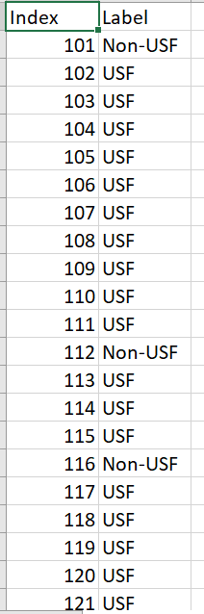
Label files

Slide 10
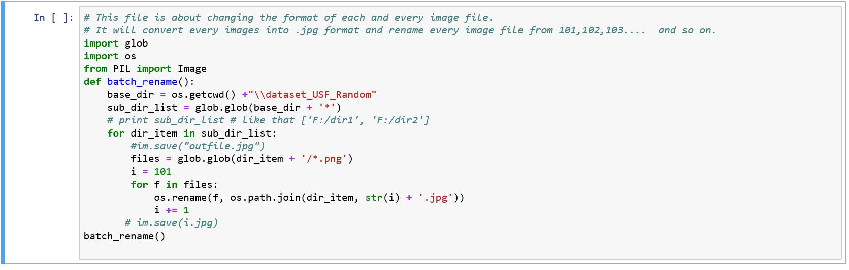
RENAMING AND FORMATTING IMAGE FILES

Slide 11

CHOOSING A MODEL
MACHINE LEARNING –
SGD CLASSIFIER
DEEP LEARNING –
CNN WITH Keras/tensorflow

Slide 12
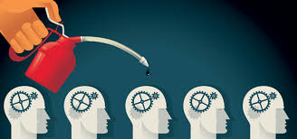
TRAINING
Shuffling of data .
Split the dataset into a separate train and test set.
Train data ratio is 80 and test data ratio is 20.

Slide 13
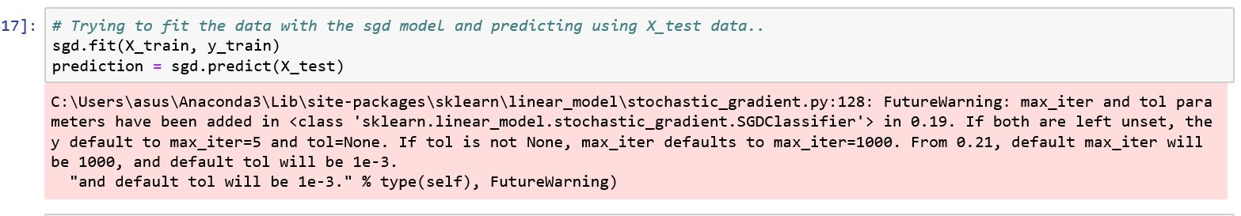
TRAINING

Slide 14

Machine learning

Slide 15
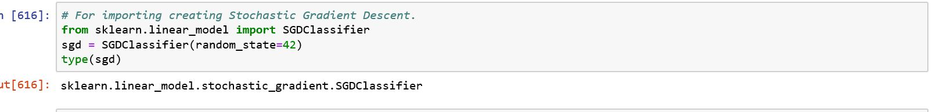
MACHINE LEARNING

Slide 16



USF AND NON-USF LOGOS (RATIO 200/100)
Collected 200 images of usf logos
Collected 100 images of non-usf logos
Merged both of them and renamed them
Cleaned the data by converting all the files in .jpg
Reshaped the data into 28 * 28
Split the data in ratio of 80/20(train /test)
Used cross-validation (cv=3())

Slide 17
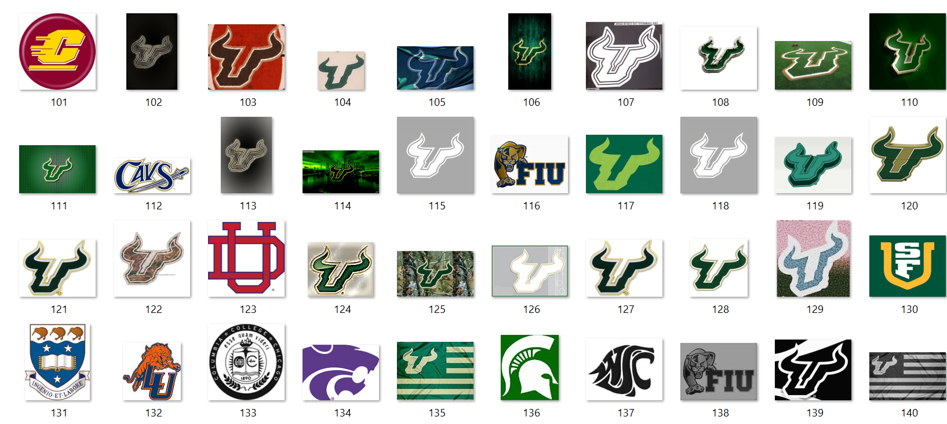

Slide 18


USF AND NON-USF LOGOS(RATIO 200/150)
Collected 200 images of usf logos
Collected 150 images of non-usf logos
Merged both of them and renamed them
Cleaned the data by converting all the files in .jpg
Reshaped the data into 28 * 28
Split the data in ratio of 80/20(train /test)
Used cross-validation (cv=3())

Slide 19


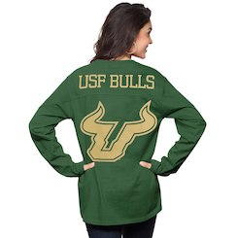

usF AS TINY PART OF IMAGE AND RANDOM IMAGES
Collected 200 images of usf logos as a tiny part of image
Collected 175 random images
Merged both of them and renamed them
Cleaned the data by converting all the files in .jpg
Reshaped the data into 28 * 28
Split the data in ratio of 80/20(train /test)
Used cross-validation (cv=3())

Slide 20
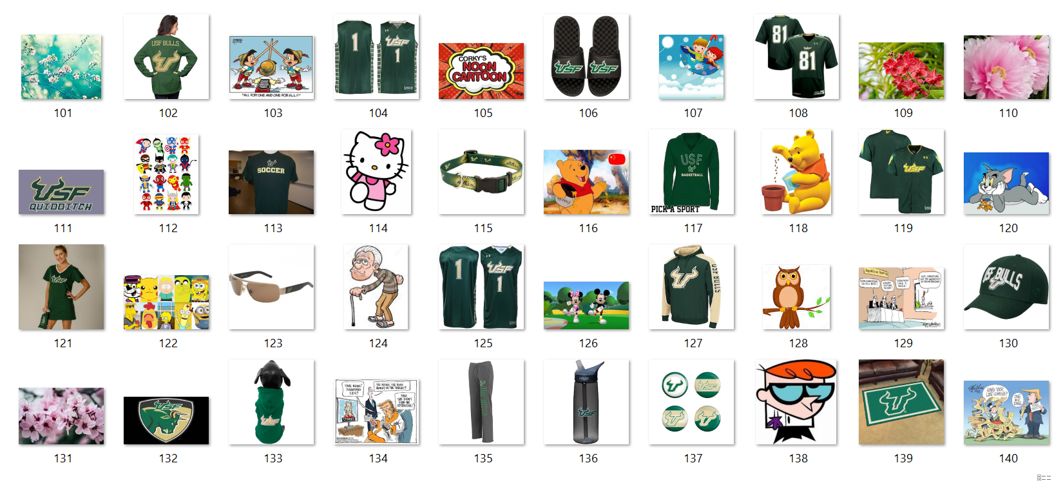

Slide 21
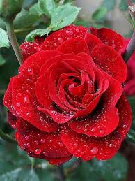
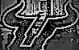
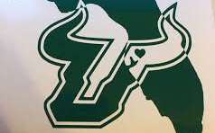
USF LOGO AND RANDOM IMAGES
Collected 200 images of usf logos
Collected 100 random images
Merged both of them and renamed them
Cleaned the data by converting all the files in .jpg
Reshaped the data into 28 * 28
Split the data in ratio of 80/20(train /test)
Used cross-validation (cv=3())

Slide 22
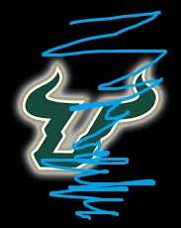
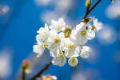

robustness USF LOGO WITH NOISE AND RANDOM IMAGES
Collected 200 images of usf logos
Added noise in the images by painting the edges or filling color
Collected 100 random images
Merged both of them and renamed them
Cleaned the data by converting all the files in .jpg
Reshaped the data into 28 * 28
Split the data in ratio of 80/20(train /test)
8. Used cross-validation (cv=3())

Slide 23
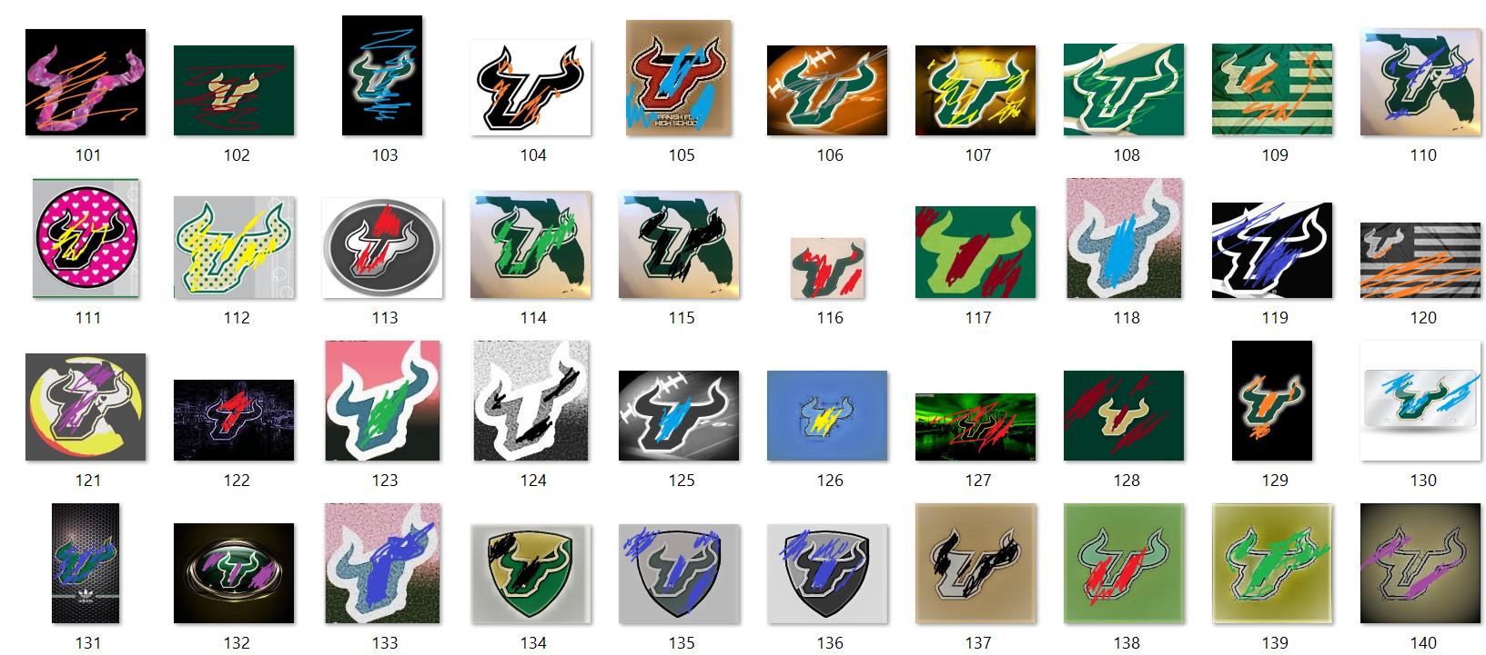

Slide 24
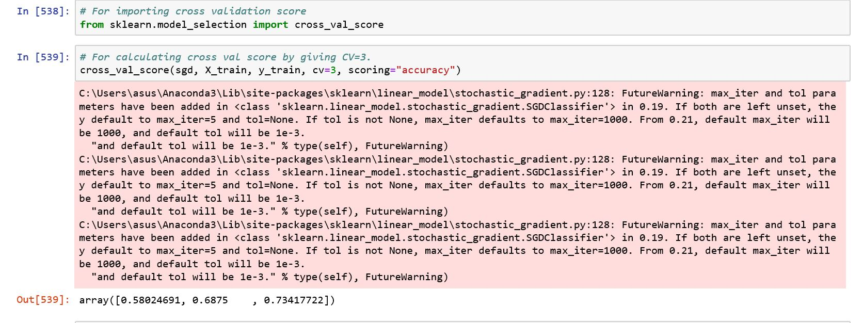
CROSS VALIDATION

Slide 25
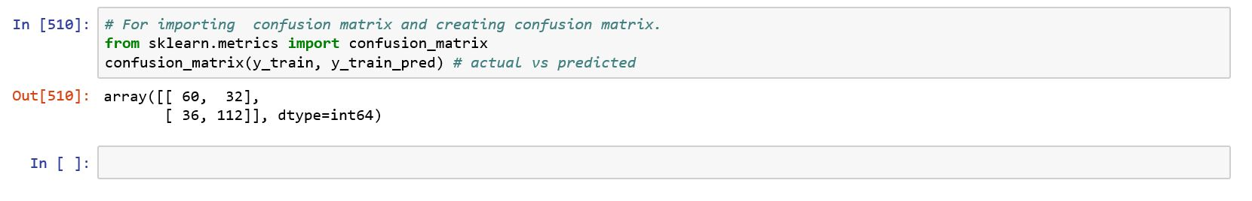
CONFUSION MATRIX

Slide 26
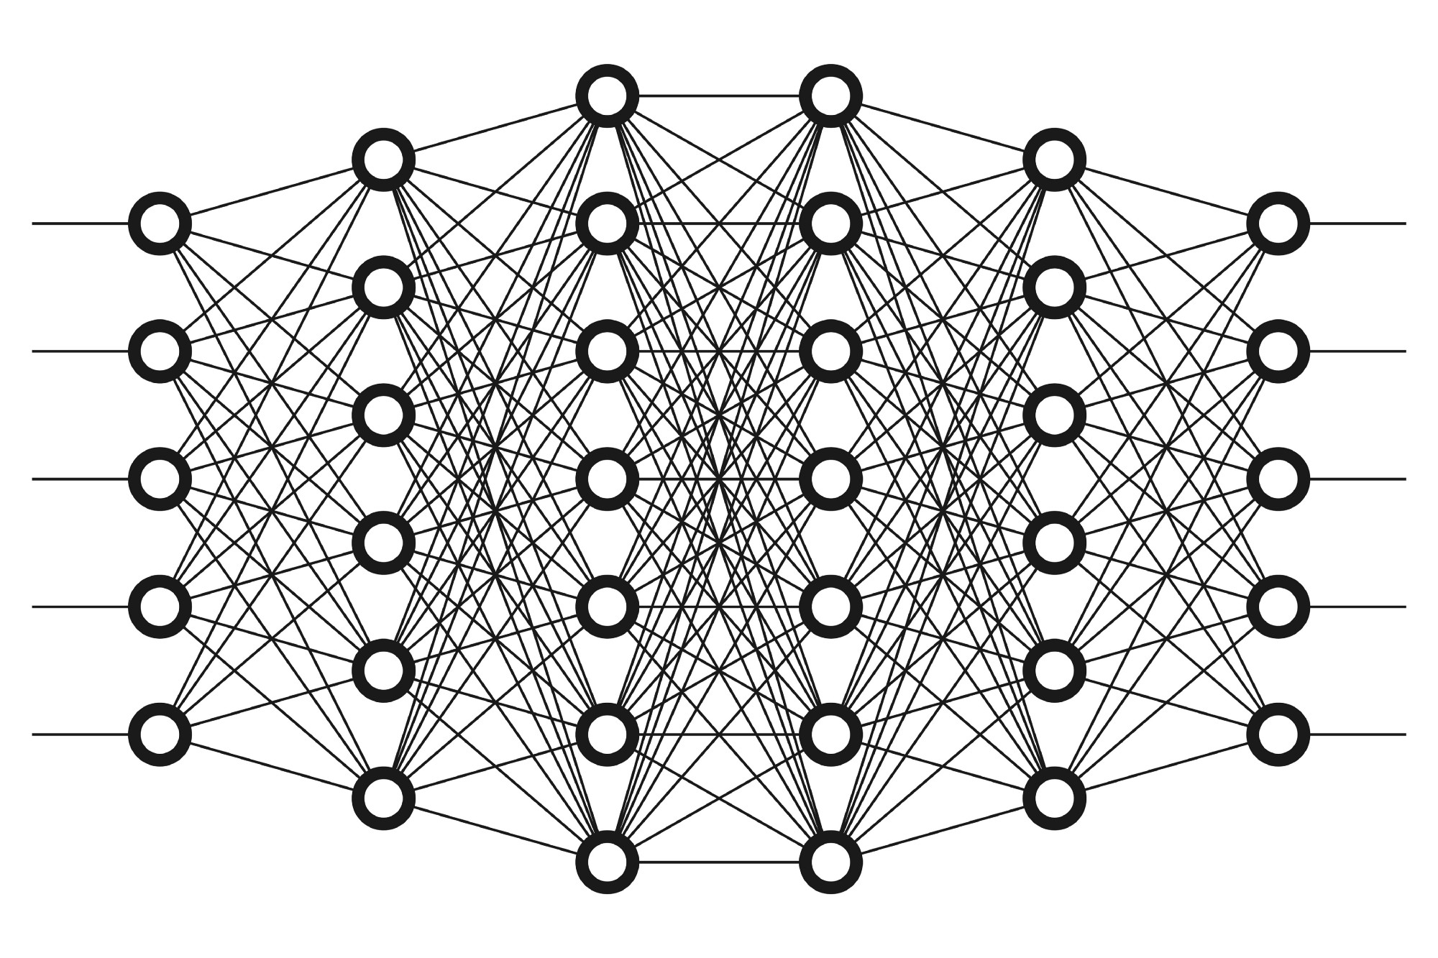
Deep learning

Slide 27
dATASET
1. usf AND Non USF (Without Noise)
2. USF anf Non USF with Noises

Slide 28
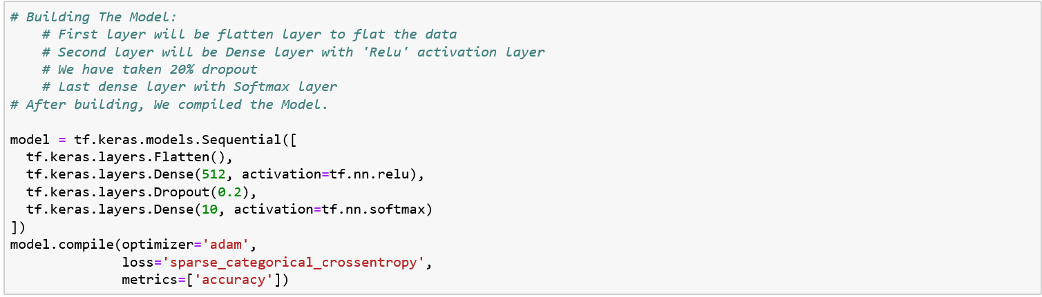
cnn

Slide 29
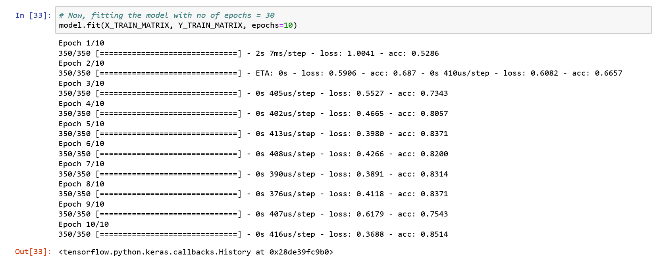

Slide 30
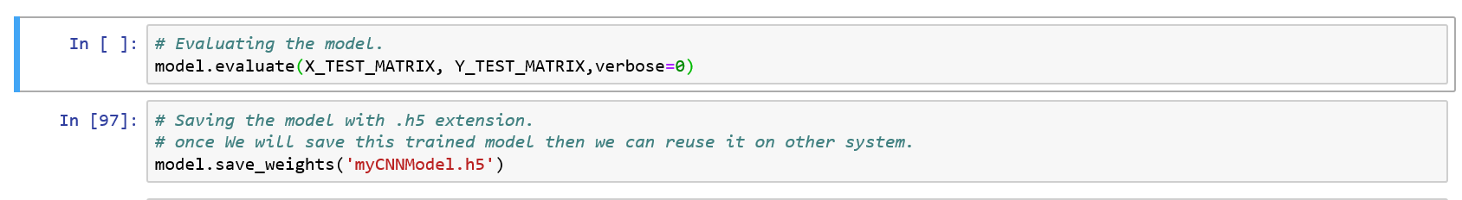

Slide 31
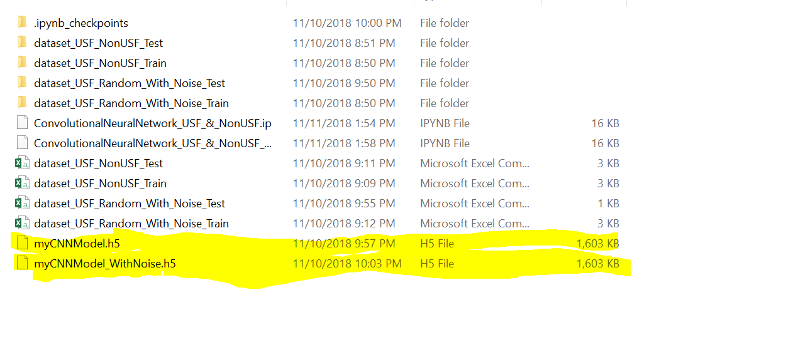
Saving the trained model

Slide 32
conclusion
So we can conclude that as we increase the dataset the accuracy of model increased .
Adding noises in dataset makes the model more robust.
To draw parallelism between machine learning and Deep learning-
-Machine learning gives better accuracy on small dataset while deep learning requires larger dataset to get better accuracy.

Slide 33
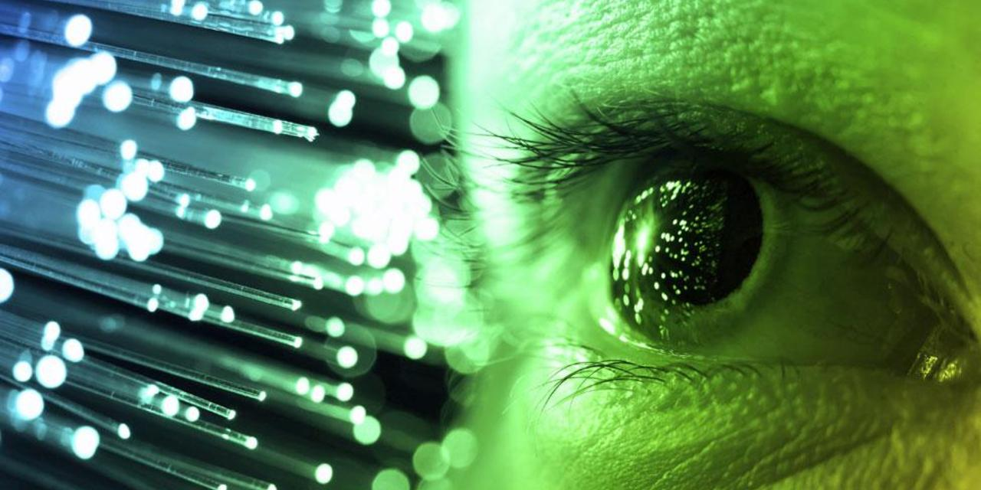
Future improvements
Add more images to the dataset
Add more noise to make the model robust
Increasing the no of layers

Slide 34


